Slide 1
Lab 2 - EEG classification
Department of Computer Science, NCTU
TA Meng-Yang, Lee

Slide 2
Important Rules
Important Date :
Report Submission Deadline: 4/14 (Tue) 11:55 p.m.
Demo date: 4/14 (Tue)
Turn in :
Experiment Report (.pdf)
Source code (.py)
Notice: zip all files in one file and name it like「DLP_LAB2_your studentID_name.zip」, ex: 「DLP_LAB2_0760447_李孟陽.zip」

Slide 3
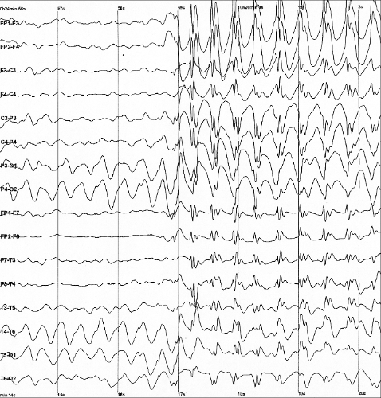
Lab Objective
In this lab, you will need to implement simple EEG classification models which are EEGNet, DeepConvNet[1] with BCI competition dataset. Additionally, you need to try different kinds of activation function including『ReLU』,『Leaky ReLU』, 『ELU』.

Slide 4
Requirements
Implement the EEGNet, DeepConvNet with three kinds of activation function including『ReLU』,『Leaky ReLU』, 『ELU』.
In the experiment results, you have to show the highest accuracy (not loss) of two architectures with three kinds of activation functions.
To visualize the accuracy trend, you need to plot each epoch accuracy (not loss) during training phase and testing phase.

Slide 5
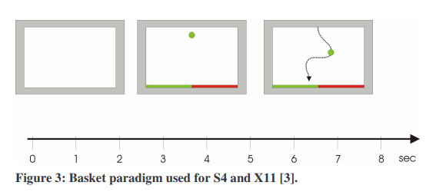
Dataset
BCI Competition III – IIIb
[2 classes, 2 bipolar EEG channels]
Reference: http://www.bbci.de/competition/iii/desc_IIIb.pdf

Slide 6
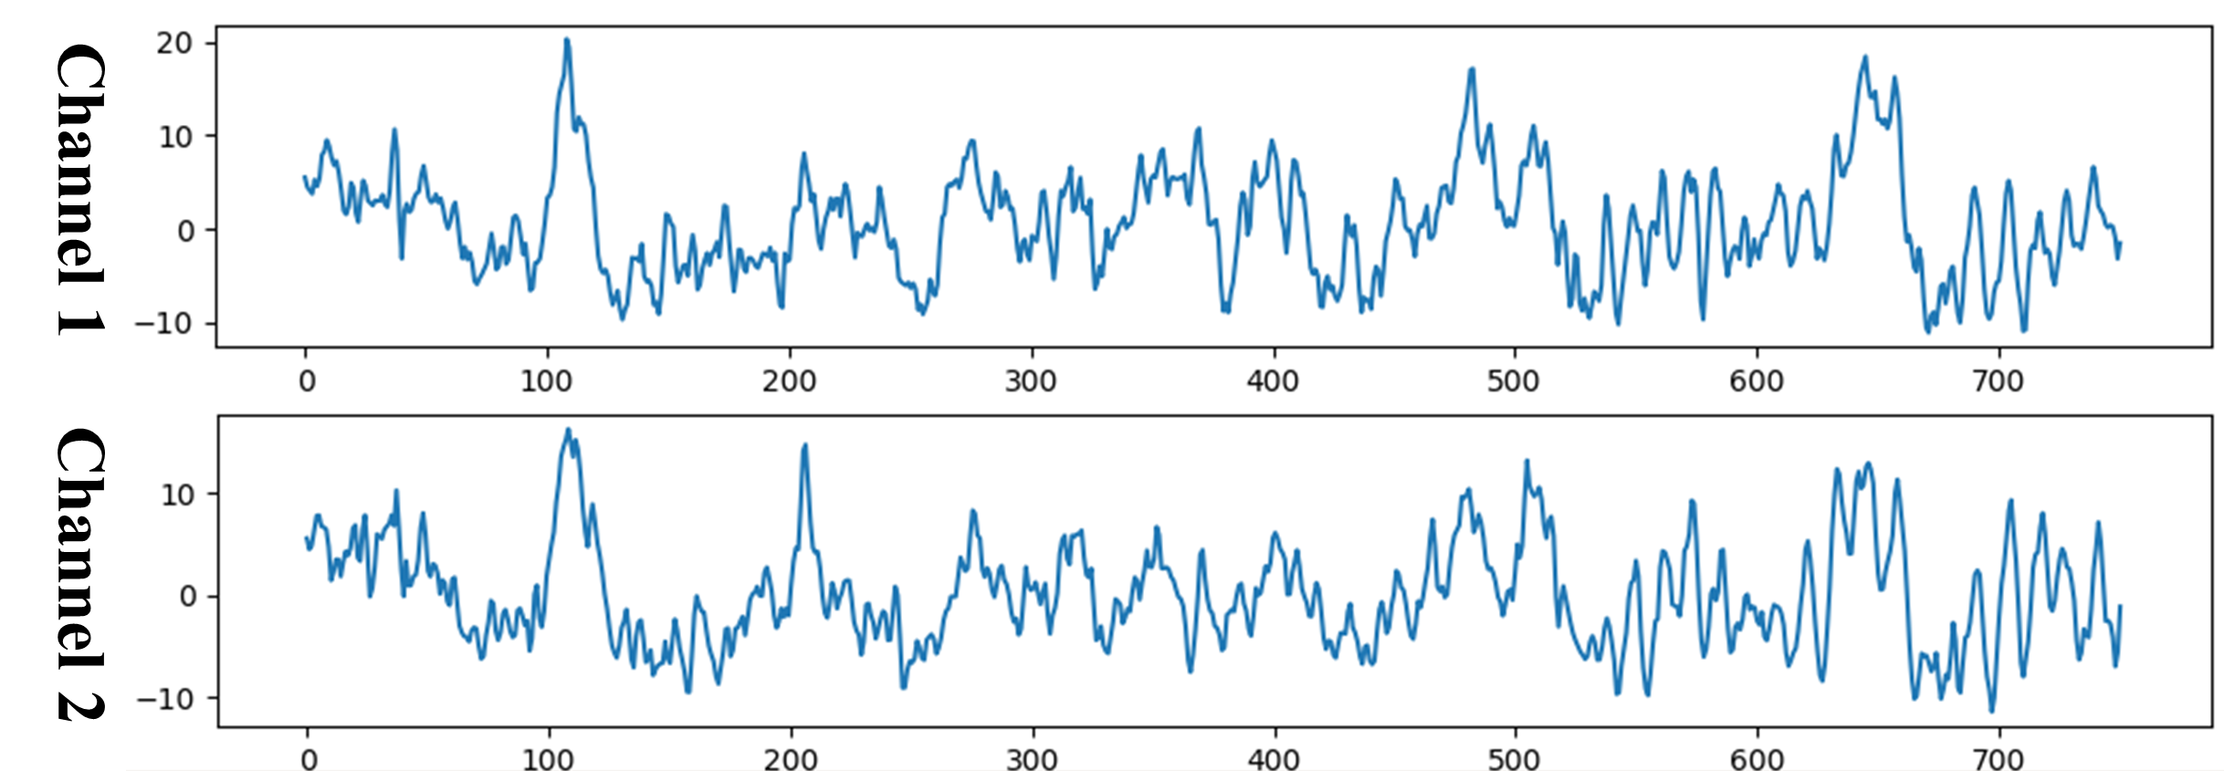
Prepare Data
Training data: S4b_train.npz, X11b_train.npz
Testing data: S4b_test.npz, X11b_test.npz
To read the preprocessed data, refer to the “dataloader.py”.
Input: [B, 1, 2, 750] Output: [B, 2] Ground truth: [B]
B: batch size

Slide 7
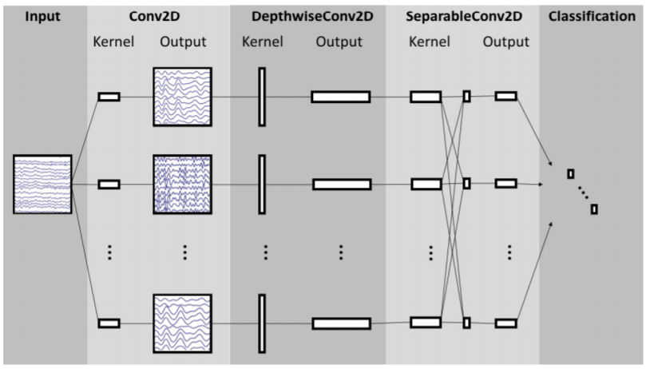
Create Model - EEGNet
Reference: Depthwise Separable Convolution
https://towardsdatascience.com/a-basic-introduction-to-separable-convolutions-b99ec3102728

Slide 8
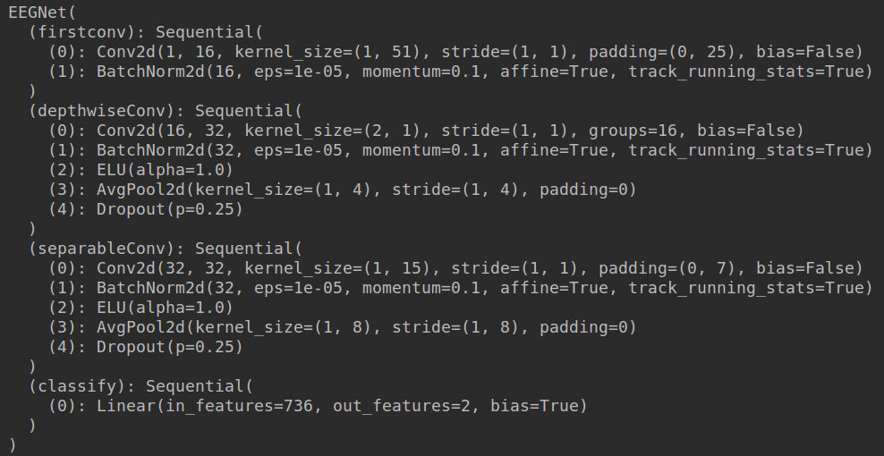
Create Model - EEGNet
EEGNet implementation details

Slide 9
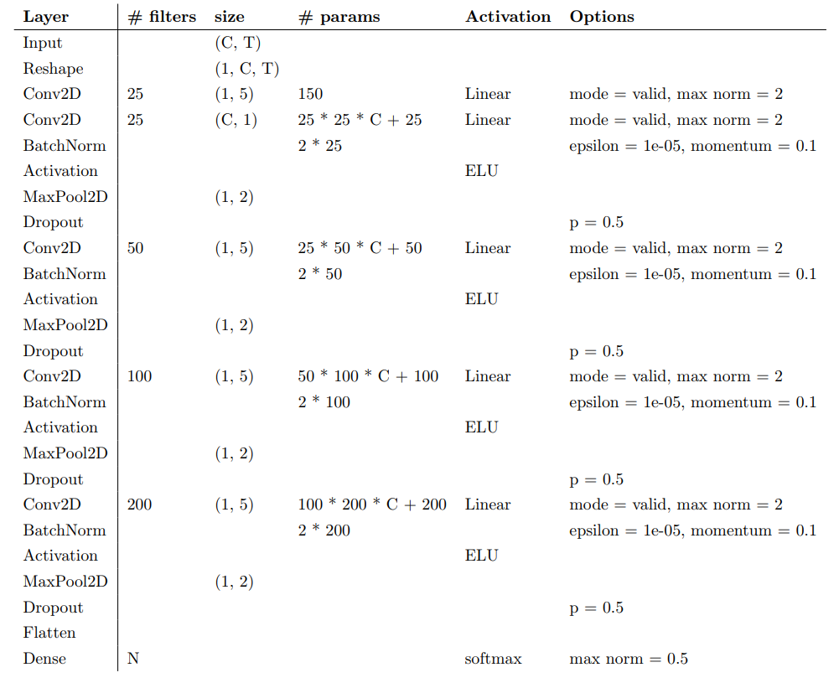
Create Model - DeepConvNet
You need to implement the DeepConvNet architecture by using the following table, where C = 2, T = 750 and N = 2. The max norm term is ignorable.
The input data has reshaped to [B, 1, C, T]

Slide 10
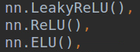
Create Model - Activation Functions
In the PyTorch framework, it is easy to implement the activation function.

Slide 11
Hyper Parameters
Batch size= 64
Learning rate = 1e-2
Epochs = 150
Optimizer: Adam
Loss function: torch.nn.CrossEntropyLoss()
You can adjust the hyper-parameters according to your own ideas.
If you use “nn.CrossEntropyLoss”, don’t add softmax after final fc layer because this criterion combines LogSoftMax and NLLLoss in one single class.

Slide 12
Result Comparison
You have to show the highest accuracy (not loss) of two architectures with three kinds of activation functions.
 | ReLU | Leaky ReLU | ELU
EEGNet | 85.33% | 84.63% | 82.93%
DeepConvNet | 82.75% | 86.33% | 85.73%

Slide 13
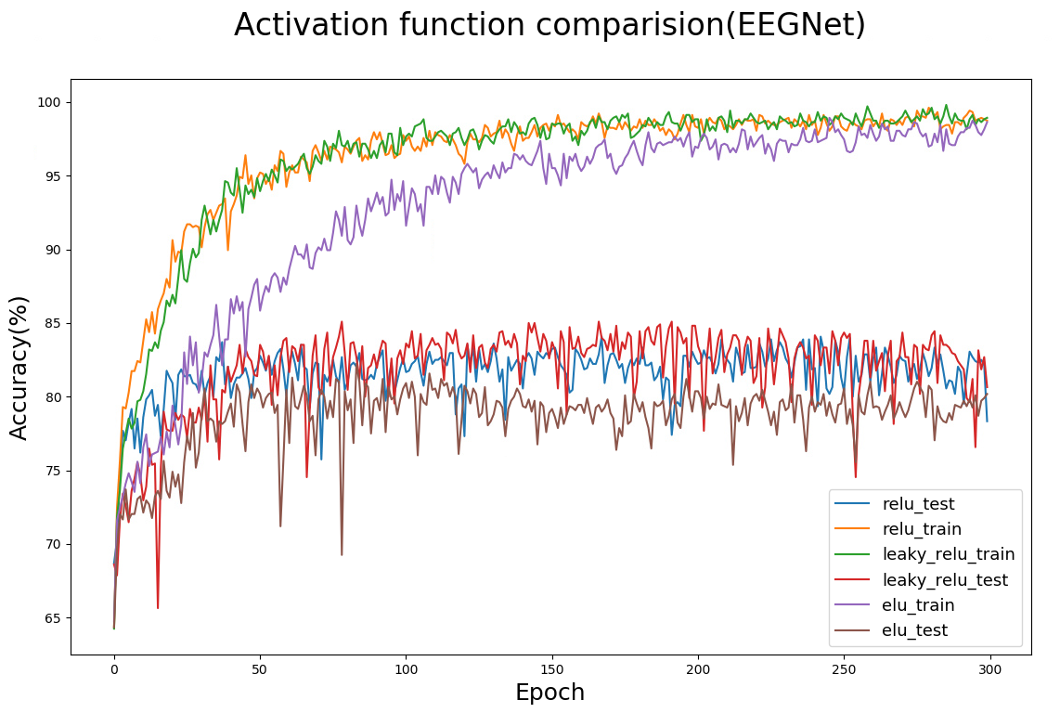
Result Comparison
To visualize the accuracy trend, you need to plot each epoch accuracy (not loss) during training phase and testing phase.
In this part, you can use the matplotlib library to draw the graph.

Slide 14
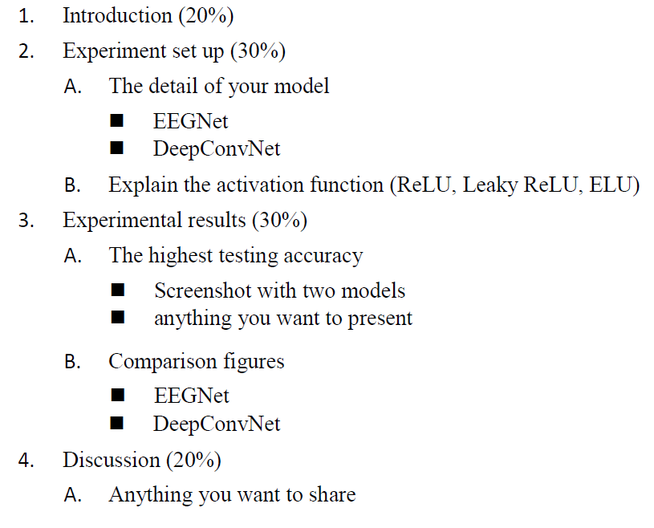
Report Spec

Slide 15
---- Criterion of result (40%) ----
Accuracy > = 87% = 100 pts
Accuracy 85~87% = 90 pts
Accuracy 80~85% = 80 pts
Accuracy 75~80% = 70 pts
Accuracy < 75% = 60 pts
Score: 40% experimental results + 60% (report+ demo score)
P.S If the zip file name or the report spec have format error, it will be penalty (-5).

Slide 16
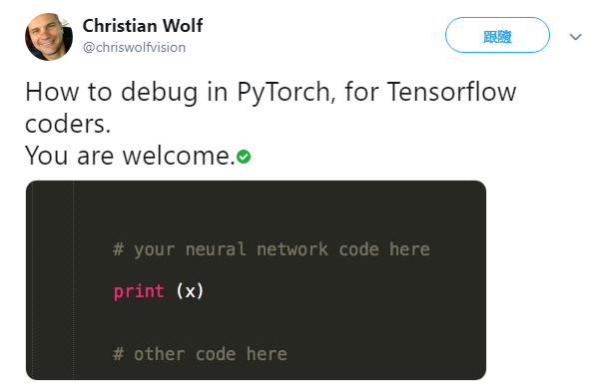
How to Debug?
Data shape or type mismatching?
Data shuffle in training?
Wrong on layer setting?

Slide 17
Reference
[1] EEGNet: A Compact Convolutional Neural Network for EEG-based Brain-Computer Interfaces

